Slide 1
CENTRAL PROCESSING UNIT
UNIT-III

Slide 2

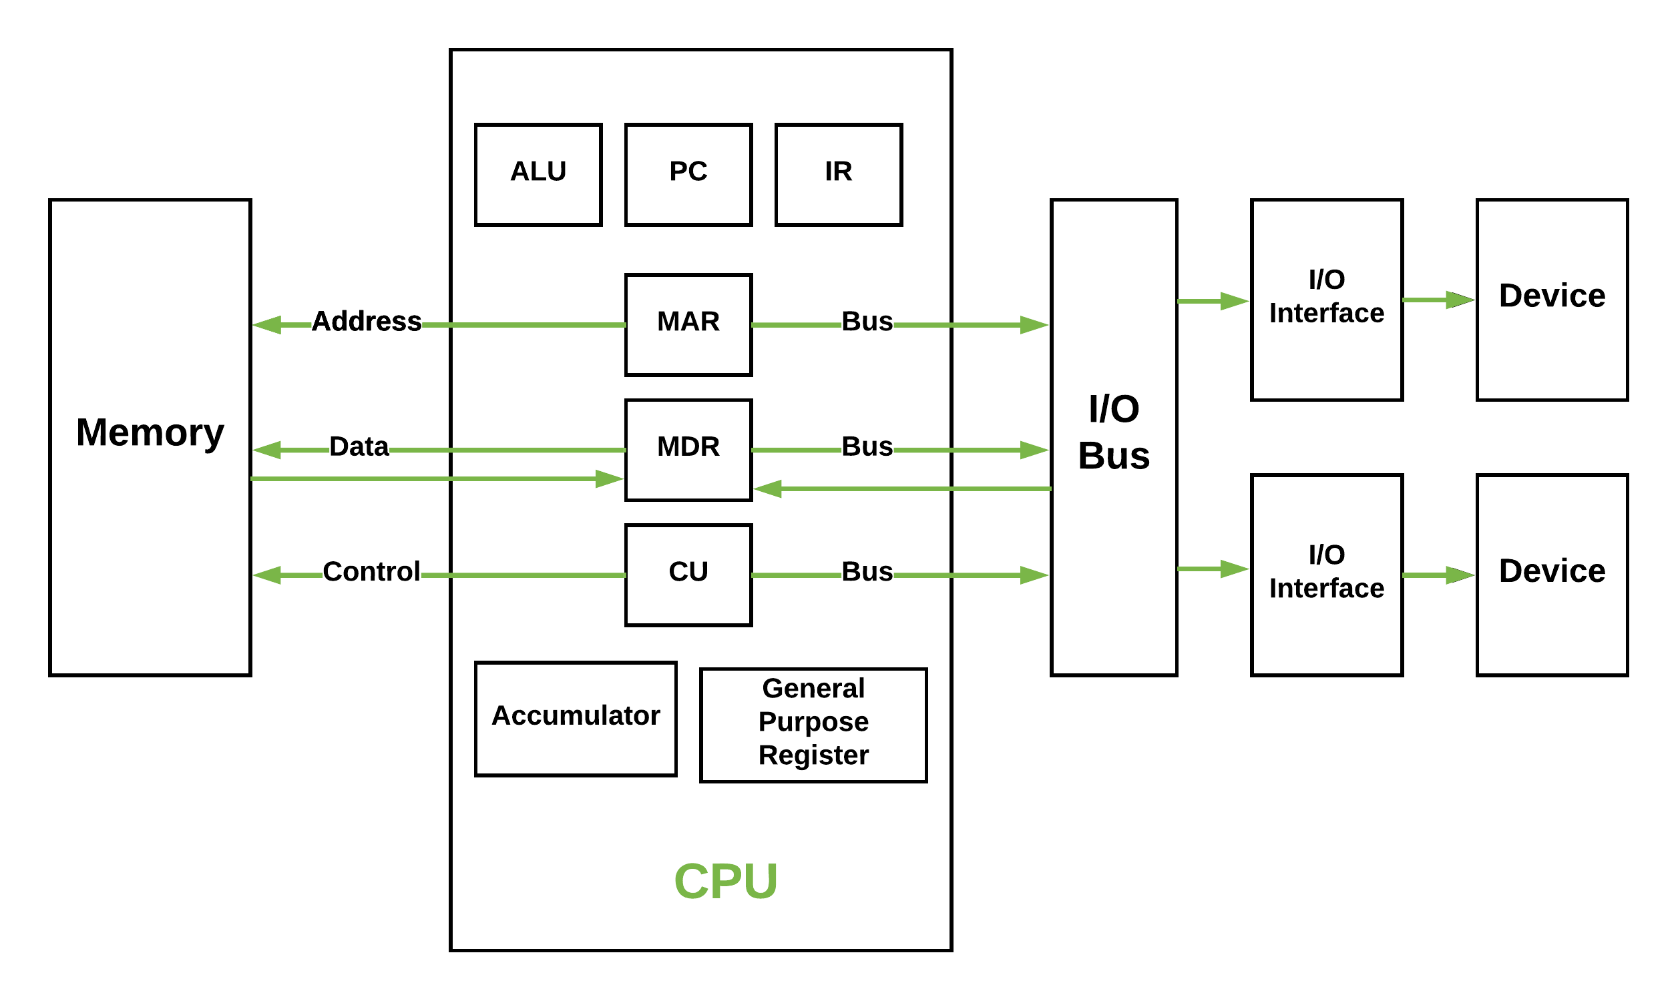

Slide 3
Processor Organization
To understand the organization of the CPU, let us consider the requirements placed on the CPU, the things that it must do:
Fetch instruction: The CPU reads an instruction from memory.
Interpret instruction: The instruction is decoded to determine what action is required.
Fetch data: The execution of an instruction may require reading data from memory or an I/O module.
Process data: The execution of an instruction may require performing some arithmetic or logical operation on data.
Write data: The results of an execution may require writing data to memory or an I/O module.
To do these things, it should be clear that the CPU needs to store some data temporarily. It must remember the location of the last instruction so that it can know where to get the next instruction. It needs to store instructions and data temporar­ily while an instruction is being executed. In other words, the CPU needs a small internal memory.
The ALU does the actual computation or processing of data.
The con­trol unit controls the movement of data and instructions into and out of the CPU and controls the operation of the ALU.

Slide 4
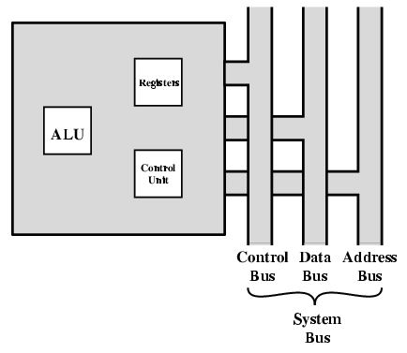
The CPU with the System Bus

Slide 5
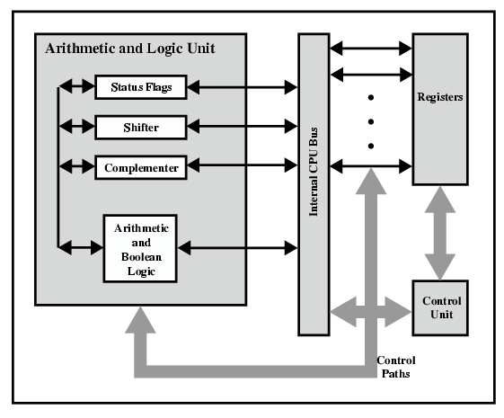
CPU Internal Structure

Slide 6
Register organization
Within the CPU, there is a set of registers that function as a level of memory above main memory and cache in the hierarchy. The registers in the CPU perform two roles:
User-visible registers: These enable the machine- or assembly-language pro­grammer to minimize main memory references by optimizing use of registers.
Control and status registers: These are used by the control unit to control the operation of the CPU and by privileged, operating system programs to control the execution of programs.
There is not a clean separation of registers into these two categories. For example, on some machines the program counter is user visible (e.g., Pentium), but on many it is not (e.g., PowerPC). For purposes of the following discussion, how­ever, we will use these categories.
User-Visible Registers
A user-visible register is one that may be referenced by means of the machine lan­guage that the CPU executes. We can characterize these in the following categories:
General purpose
Data
Address
Condition codes

Slide 7
General-purpose registers: can be assigned to a variety of functions by the pro­grammer. Sometimes their use within the instruction set is orthogonal to the opera­tion. That is, any general--purpose register can contain the operand for any opcode.
Data registers may be used only to hold data and cannot be employed in the calculation of an operand address.
Address registers may themselves be somewhat general purpose, or they may be devoted to a particular addressing mode.
Condition codes register (also referred to as flags): Condition codes are bits set by the CPU hardware as the result of operations. For example, an arithmetic operation may pro­duce a positive, negative, zero, or overflow result. In addition to the result itself being stored in a register or memory, a condition code is also set. The code may sub­sequently be tested as part of a conditional branch operation.

Slide 8
Control and Status Registers
There are a variety of CPU registers that are employed to control the operation of the CPU. Most of these, on most machines, are not visible to the user. Some of them may be visible to machine instructions executed in a control or operating system mode.
Of course, different machines will have different register organizations and use different terminology. We list here a reasonably complete list of register types, with a brief description.
Four registers are essential to instruction execution:
Program counter (PC): Contains the address of an instruction to be fetched.
Instruction register (IR): Contains the instruction most recently fetched.
Memory address registers (MAR): Contains the address of a location in memory.
Memory buffer register (MBR): Contains a word of data lo be written to mem­ory or the word most recently read.

Slide 9
All CPU designs include a register or set of registers, often known as the program status word (PSW), that contain status information. The PSW typically con­tains condition codes plus other stains information. Common fields or flags include the following:
Sign: Contains the sign bit of the result of the last arithmetic operation.
Zero: Set when the result is 0.
Carry: Set if an operation resulted in a carry (addition) into or borrow (sub-traction) out of a high-order hit. Used for multiword arithmetic operations.
Equal: Set if a logical compare result is equality.
Overflow: Used to indicate arithmetic overflow
Interrupt enable/disable: Used to enable or disable interrupts.
Supervisor: Indicates whether the CPU is executing in supervisor or user mode. Certain privileged instructions can be executed only in supervisor mode, and certain areas of memory can be accessed only in supervisor mode.

Slide 10
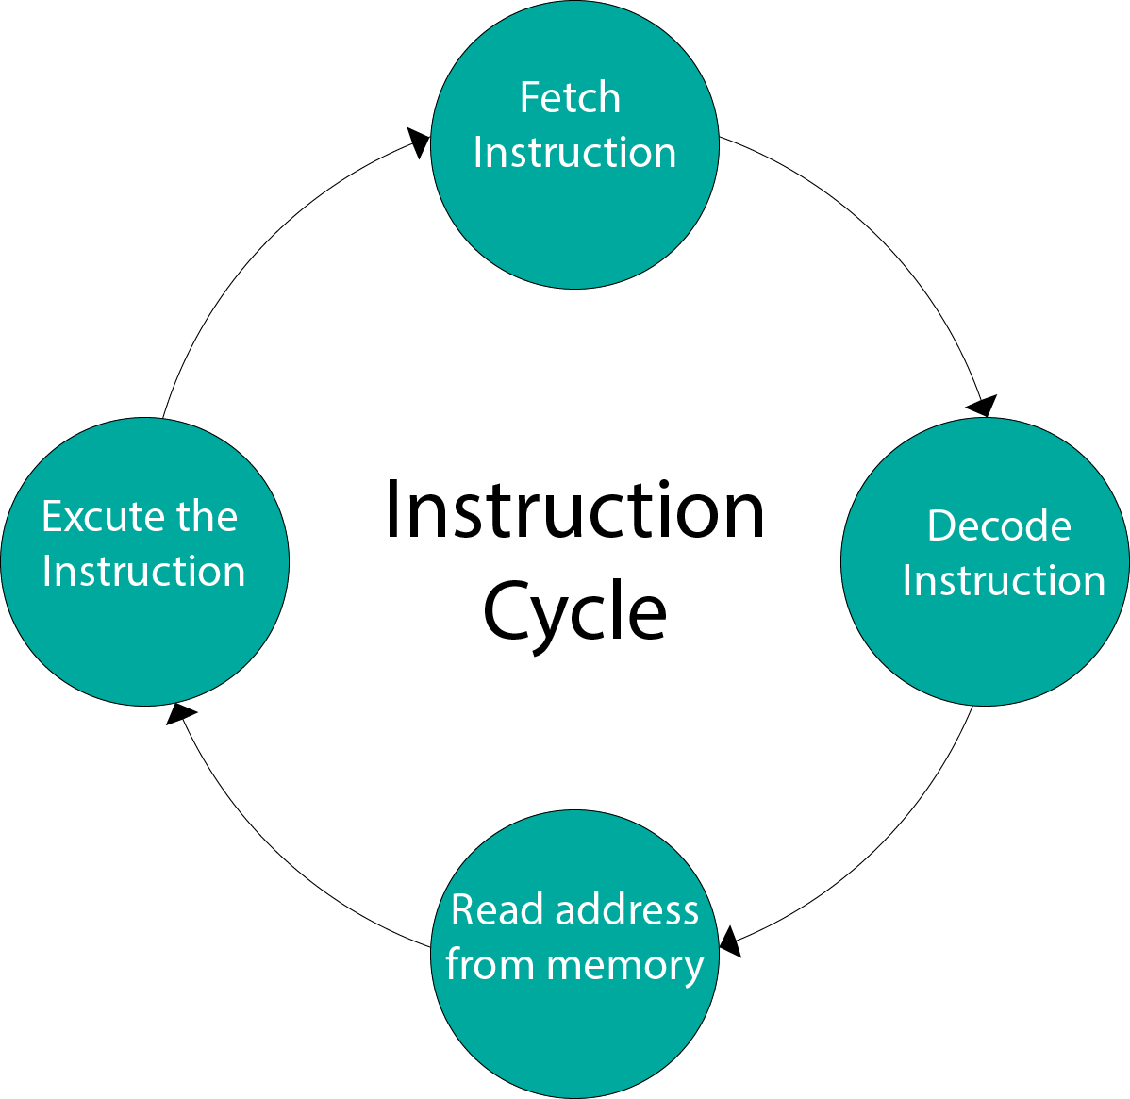
Instruction Cycle
A program residing in the memory unit of a computer consists of a sequence of instructions. These instructions are executed by the processor by going through a cycle for each instruction.
In a basic computer, each instruction cycle consists of the following phases:
Fetch instruction from memory.
Decode the instruction.
Read the effective address from memory.
Execute the instruction.

Slide 11
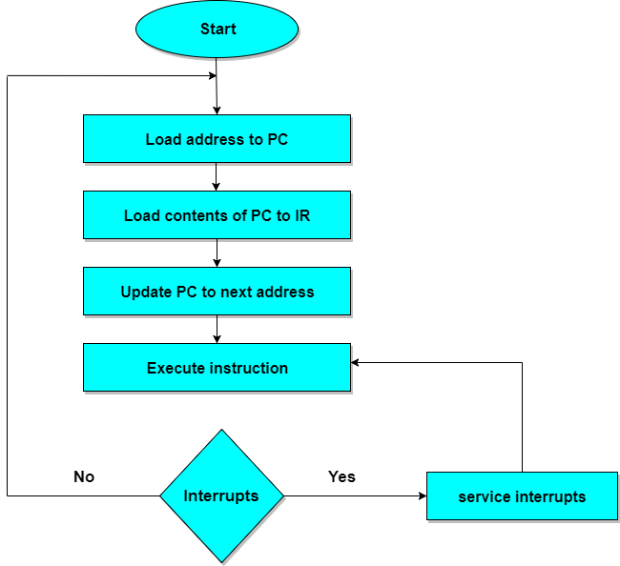
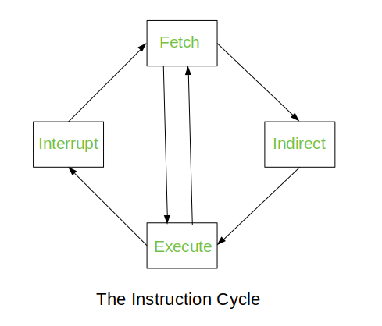
Instruction Cycle and flow chart

Slide 12
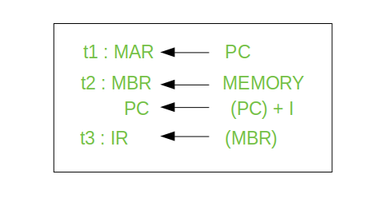
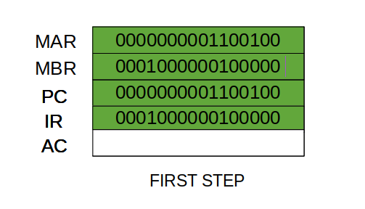
Fetch Cycle
The address instruction to be implemented is held at the program counter. The processor fetches the instruction from the memory that is pointed by the PC.
Next, the PC is incremented to display the address of the next instruction. This instruction is loaded onto the instruction register. The processor reads the instruction and executes the important procedures.
A simple Fetch Cycle consist of three steps and four micro-operation. Symbolically, we can write these sequence of events as follows:-
First time unit: Move the contents of the PC to MAR.
Second time unit: Move contents of memory location specified by MAR to MBR. Increment content of PC by I.
Third time unit: Move contents of MBR to IR.

Slide 13
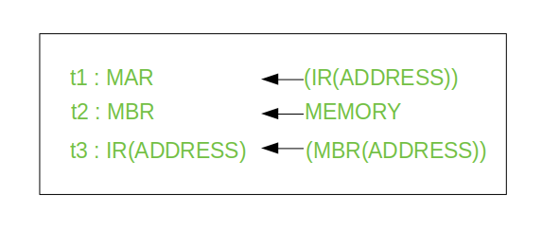
The Indirect Cycles – Once an instruction is fetched, the next step is to fetch source operands. Source Operand is being fetched by indirect addressing( it can be fetched by any addressing mode, here its done by indirect addressing). Register-based operands need not be fetched. Once the opcode is executed, a similar process may be needed to store the result in main memory. Following micro-operations takes place:-
Step 1: The address field of the instruction is transferred to the MAR. This is used to fetch the address of the operand.
Step 2: The address field of the IR is updated from the MBR.(So that it now contains a direct addressing rather than indirect addressing)
Step 3: The IR is now in the state, as if indirect addressing has not been occurred.

Slide 14
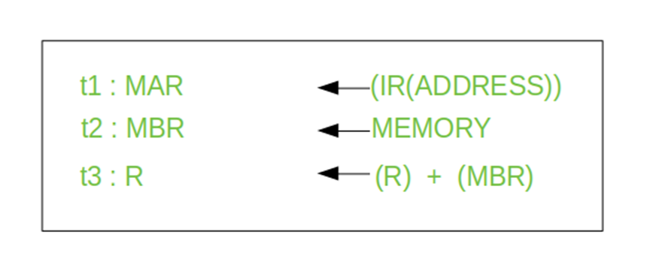
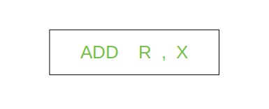
Execute Cycle
The data transfer for implementation takes place in two methods are as follows −
Processor-memory − The data sent from the processor to memory or from memory to processor.
Processor-Input/Output − The data can be transferred to or from a peripheral device by the transfer between a processor and an I/O device.
The other three cycles(Fetch, Indirect and Interrupt) are simple and predictable. Each of them requires simple, small and fixed sequence of micro-operation. In each case same micro-operation are repeated each time around.
Execute Cycle is different from them. Like, for a machine with N different opcodes there are N different sequence of micro-operations that can occur.
We begin with the IR containing the ADD instruction.
Step 1: The address portion of IR is loaded into the MAR.
Step 2: The address field of the IR is updated from the MBR, so the reference memory location is read.
Step 3: Now, the contents of R and MBR are added by the ALU.

Slide 15
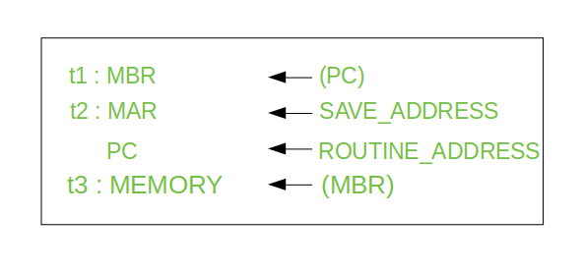
The Interrupt Cycle:
At the completion of the Execute Cycle, a test is made to determine whether any enabled interrupt has occurred or not. If an enabled interrupt has occurred then Interrupt Cycle occurs. The nature of this cycle varies greatly from one machine to another. Lets take a sequence of micro-operation:-
Step 1: Contents of the PC is transferred to the MBR, so that they can be saved for return.
Step 2: MAR is loaded with the address at which the contents of the PC are to be saved.
PC is loaded with the address of the start of the interrupt-processing routine.
Step 3: MBR, containing the old value of PC, is stored in memory.

Slide 16
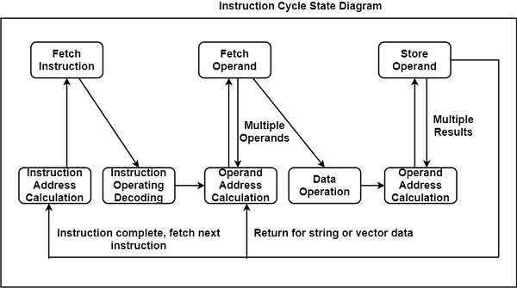
State Diagram for Instruction Cycle
The figure provides a large aspect of the instruction cycle of a basic computer, which is in the design of a state diagram. For an instruction cycle, various states can be null, while others can be visited more than once.

Slide 17
Instruction Address Calculation − The address of the next instruction is computed. A permanent number is inserted to the address of the earlier instruction.
Instruction Fetch − The instruction is read from its specific memory location to the processor.
Instruction Operation Decoding − The instruction is interpreted and the type of operation to be implemented and the operand(s) to be used are decided.
Operand Address Calculation − The address of the operand is evaluated if it has a reference to an operand in memory or is applicable through the Input/Output.
Operand Fetch − The operand is read from the memory or the I/O.
Data Operation − The actual operation that the instruction contains is executed.
Store Operands − It can store the result acquired in the memory or transfer it to the I/O.

Slide 18
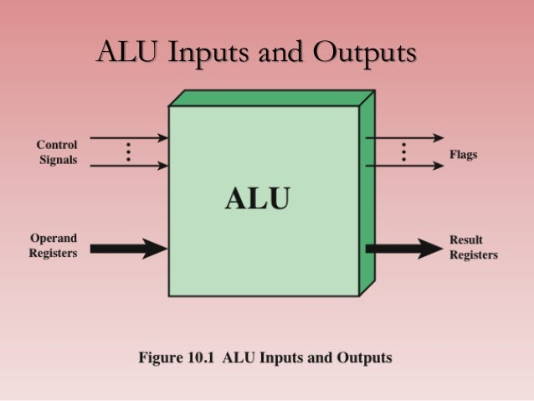

Slide 19
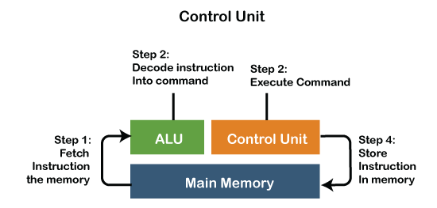

Slide 20
Arithmetic Logic Unit (ALU) Signals
A variety of input and output electrical connections are contained by the ALU, which led to casting the digital signals between the external electronics and ALU.
ALU input gets signals from the external circuits, and in response, external electronics get outputs signals from ALU.
Data: Three parallel buses are contained by the ALU, which include two input and output operand. These three buses handle the number of signals, which are the same.
Opcode: When the ALU is going to perform the operation, it is described by the operation selection code what type of operation an ALU is going to perform arithmetic or logic operation.
Status
Output: The results of the ALU operations are provided by the status outputs in the form of supplemental data as they are multiple signals.
Input: When ALU once performs the operation, the status inputs allow ALU to access further information to complete the operation successfully.

Slide 21
Advantages of ALU
ALU has various advantages, which are as follows:
It supports parallel architecture and applications with high performance.
It has the capability of performing instructions on a very large set and has a high range of accuracy.
Two arithmetic operations in the same code like addition and multiplication or addition and subtraction, or any two operands can be combined by the ALU. For case, A+B*C.
In general, it is very fast; hence, it provides results quickly.
There are no sensitivity issues and no memory wastage with ALU.
They are less expensive and minimize the logic gate requirements

Slide 22
Disadvantages of ALU
With the ALU, floating variables have more delays, and the designed controller is not easy to understand.
The bugs would occur in our result if memory space were definite.
It is difficult to understand amateurs as their circuit is complex; also, the concept of pipelining is complex to understand.
A proven disadvantage of ALU is that there are irregularities in latencies.
Another demerit is rounding off, which impacts accuracy.

Slide 23
Design Principles for Modern Computers
All instructions directly executed by hardware
Maximise rate at which instructions are issued
Instructions should be easy to decode
Only loads, stores should reference memory
Provide plenty of registers

